Slide 1
Scrum retrospective

Slide 2

(1) Sprint Planning
Development
Sprint Demo
Sprint Retrospective
(2) Daily Standup
Development
One- Week Sprint Ritual
Daily Standup Development
Daily Standup Development

Slide 3
SCRUM retrospective
The retrospective includes three main questions/points for discussion:
What went well during the sprint cycle?
What went wrong during the sprint cycle?
What could we do differently to improve?

Slide 4
Key elements of the sprint retrospective:
Process improvements are made at the end of every sprint. This ensures that the project team is always improving the way it works.
The retrospective is a collaborative process among all members, including the team, the product owner, and the Scrum Master.
All team members identify what went well and what could be improved.
The Scrum Master prioritizes actions and lessons learned based on team direction.
The retrospective supports team formation and bonding, particularly as any areas of conflict can be identified and dealt with.
The retrospective helps build the team's sense of ownership and its self- management.

Slide 5
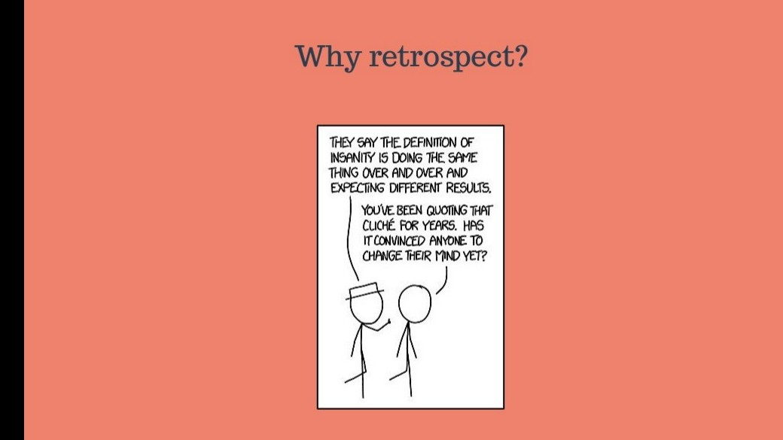

Slide 6
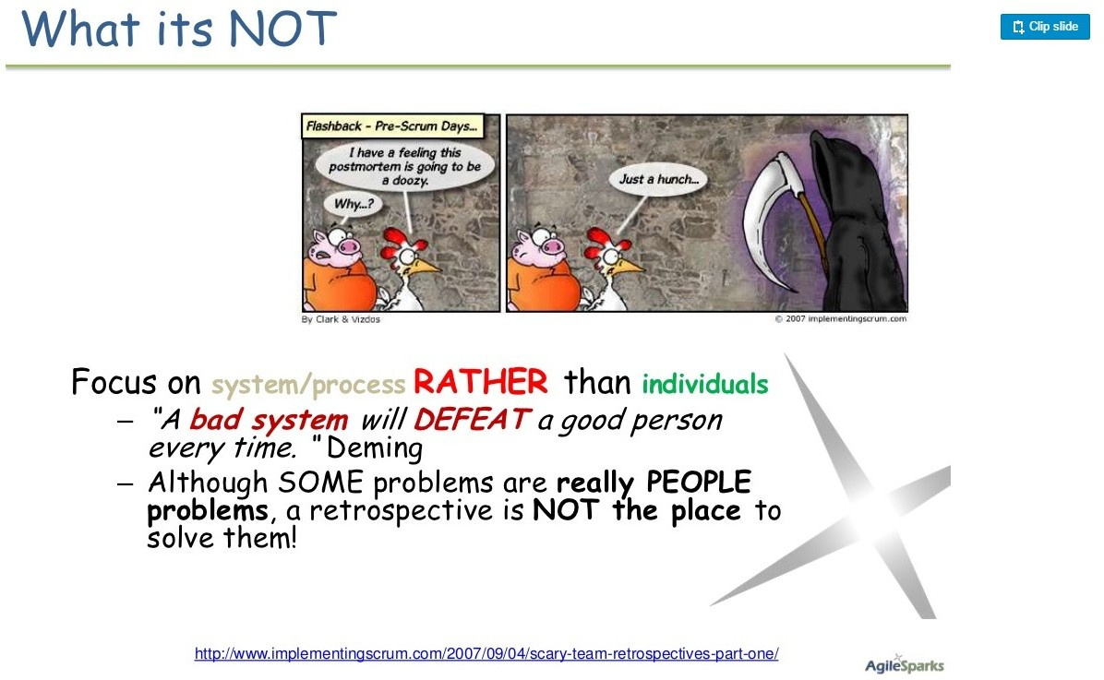

Slide 7
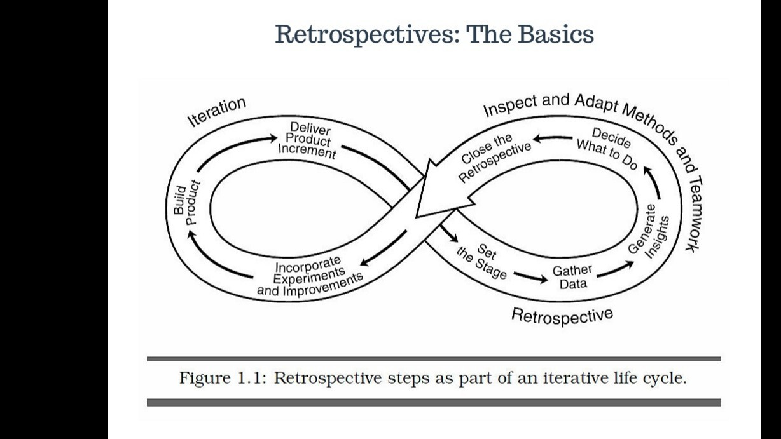

Slide 8


Slide 9


Slide 10

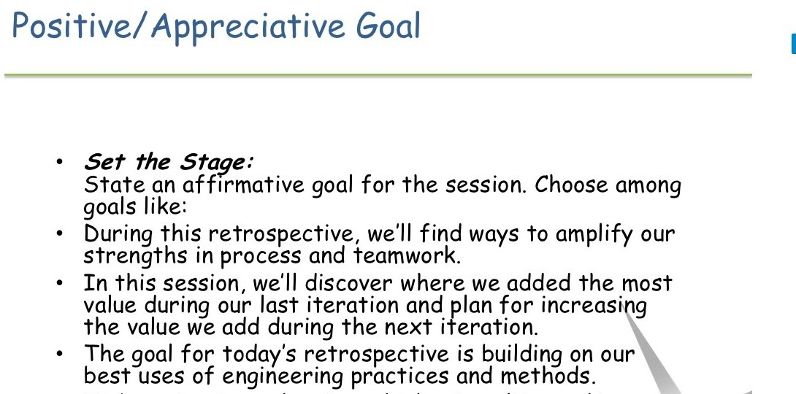

Slide 11


Slide 12
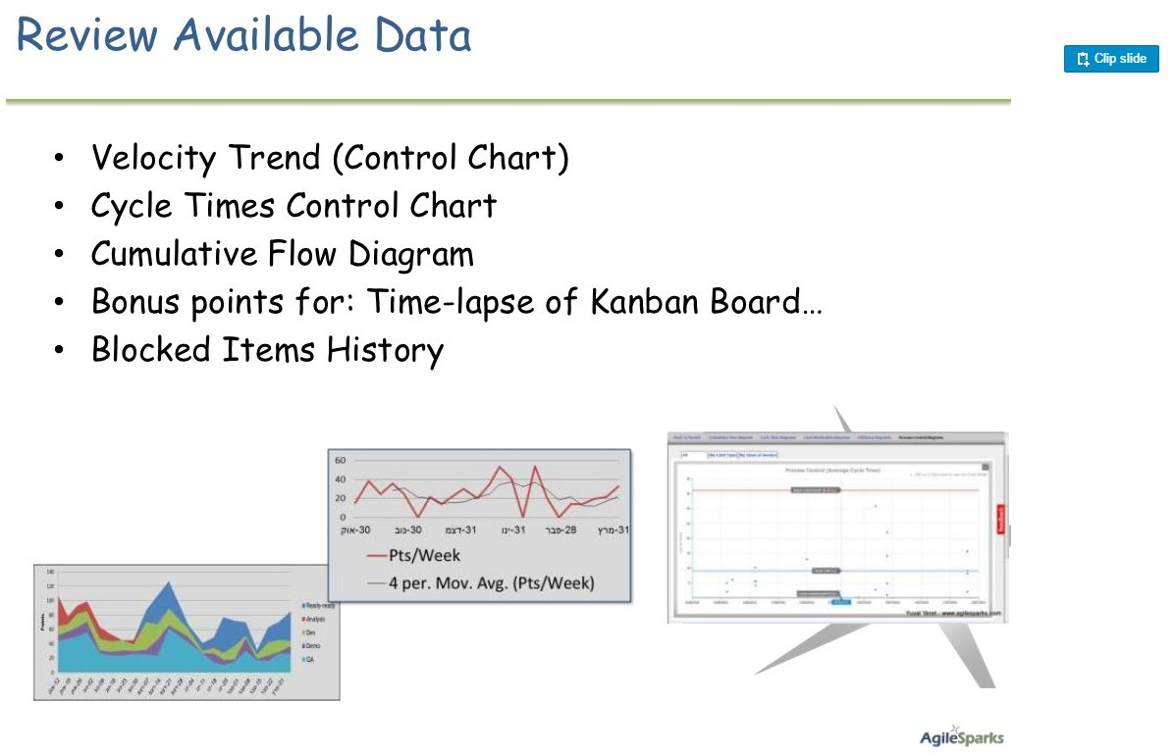

Slide 13


Slide 14
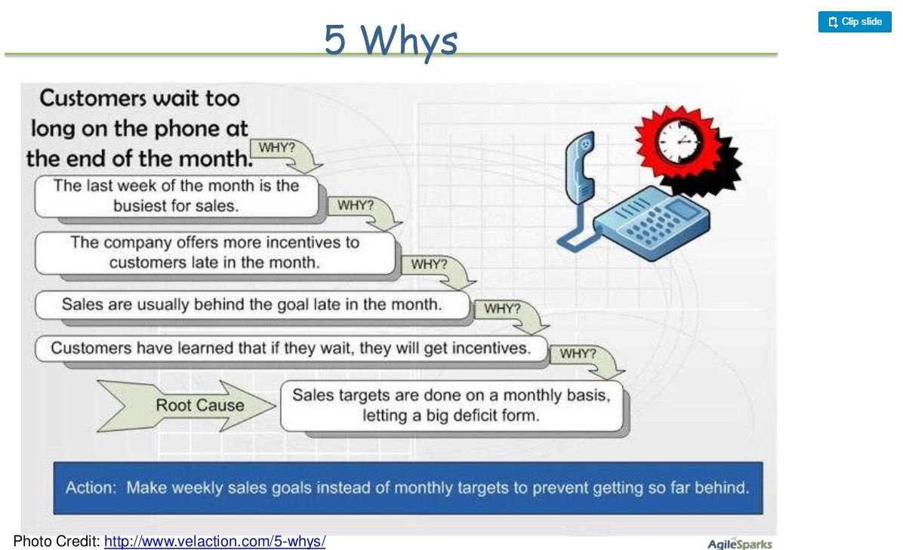

Slide 15
Focus on 3 Ws
WWW means it worked, kind of worked, and didn't work at all.
As the words suggest, the team is focused on the items that worked well for them in the last sprint.
On items that worked but still need a few tweaks in the next sprint.
Also, the team focuses on items that didn't work well or couldn't be implemented in this sprint but could be improved or implemented in upcoming sprints.

Slide 16
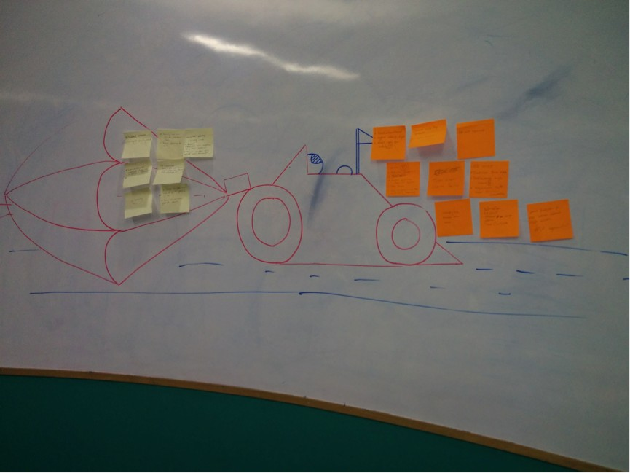
Retrospective tricks

Slide 17
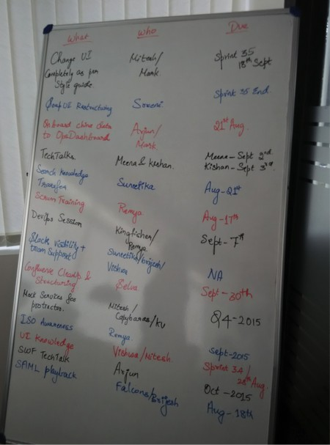

Slide 18
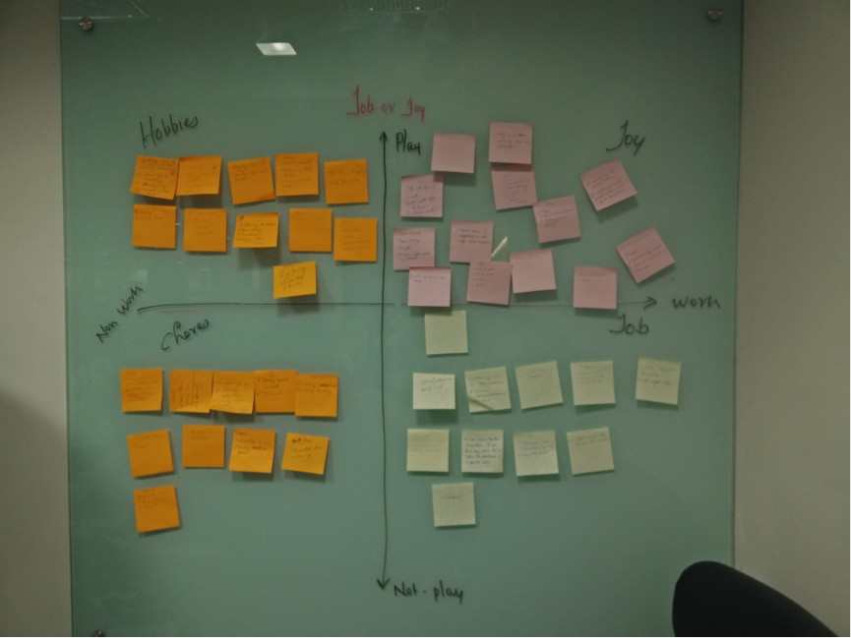

Slide 19
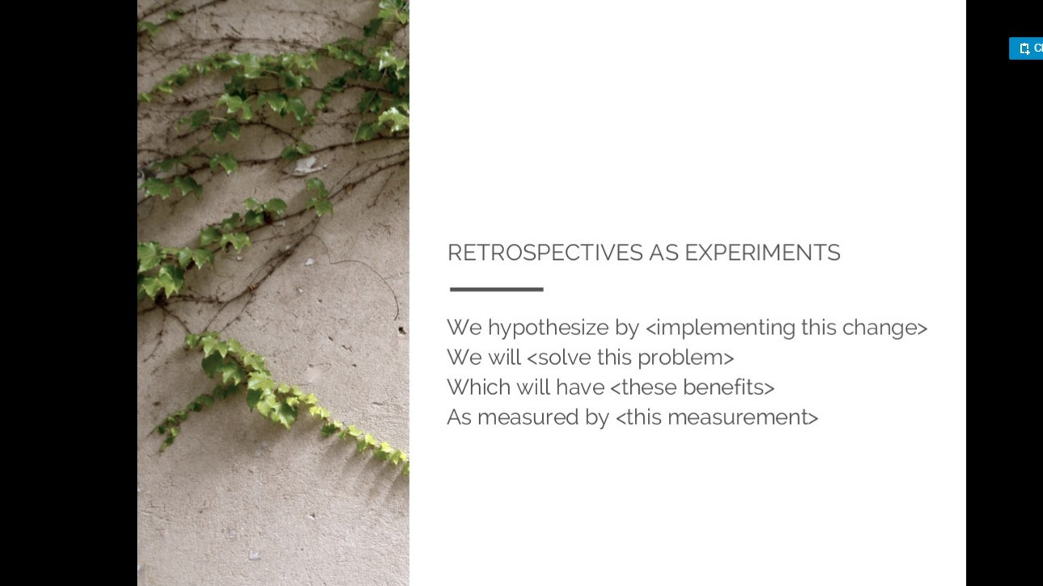

Slide 20


